Slide 1

Stay Safe in Boston
VisTa
Group Member:
Chen Lizhu, Li Haotian, Zhai Qinwen, Zhao Luo Chen

Slide 2
Data Overview
Tasks
Agenda
System Designs
Summary

Slide 3

Data Overview
Crimes in Boston
1
About the Data
2
Inspirations: Graphs
Acknowledgements:
The data is provided by Analyze Boston.

Slide 4
About the Data
Context
Crime incident reports are provided by Boston Police Department (BPD) to document the initial details surrounding an incident to which BPD officers respond.
Content
Records begin in June 14, 2015 and continue to September 3, 2018.
Includes attributes such as the type of incident(crime group) as well as when and where it occurred.

Slide 5

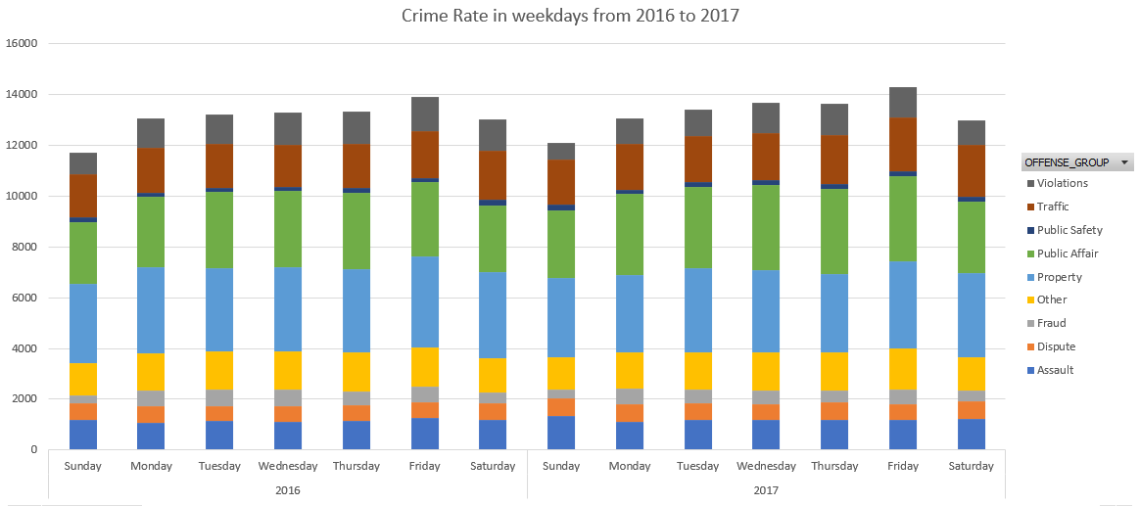
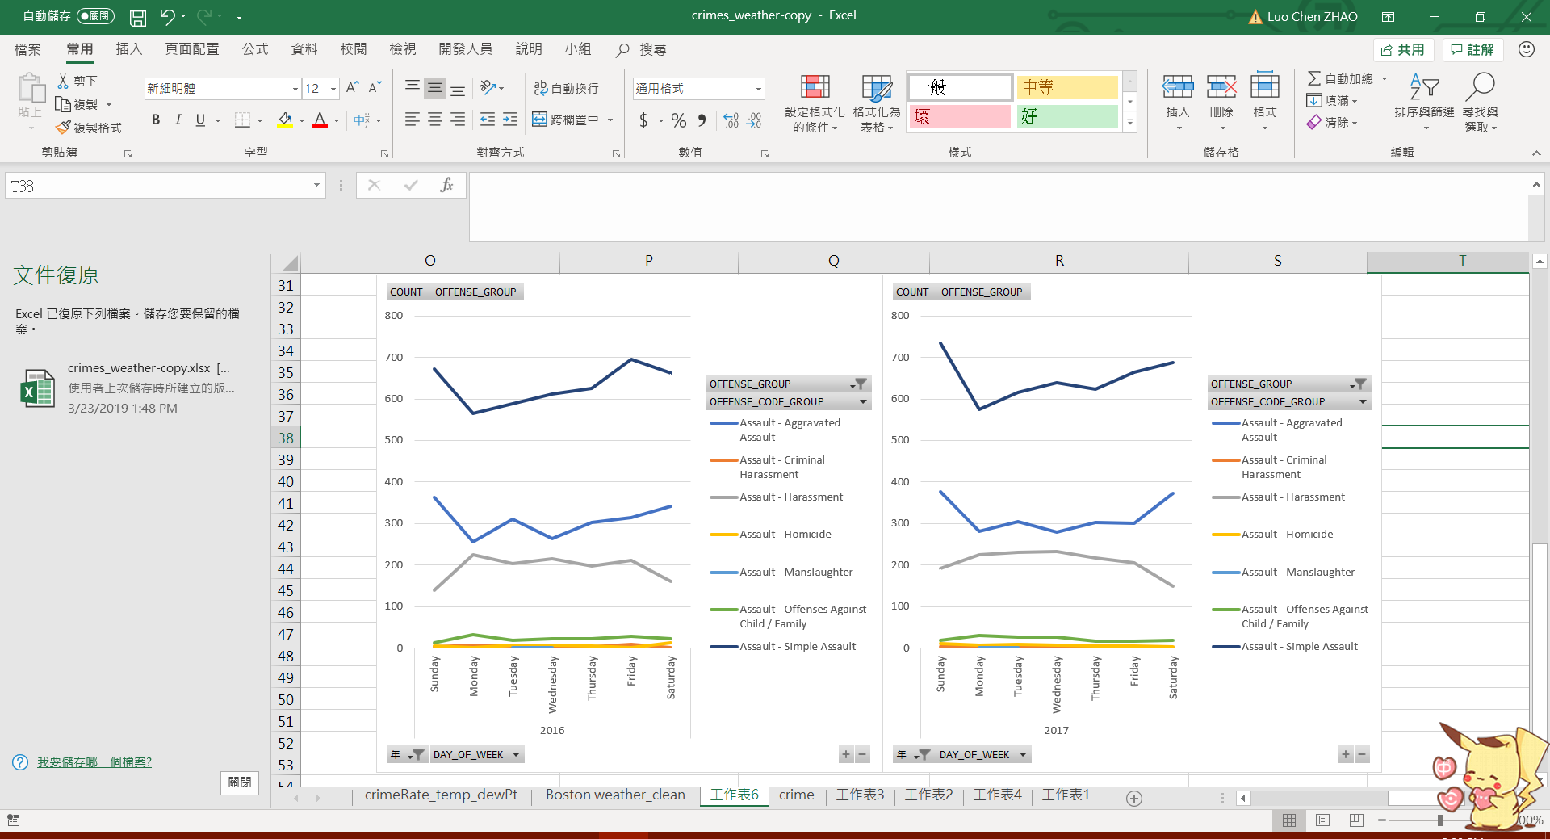
Simple Assault
Robbery
About the Data(cont.)
Property Lost
Inspiration
What types of crimes are most common?
Where are different types of crimes most likely to occur?
Does the frequency of crimes change over the day? Week? Year?
Verbal Disputes
Motor Vehicle Accident Response

Slide 6
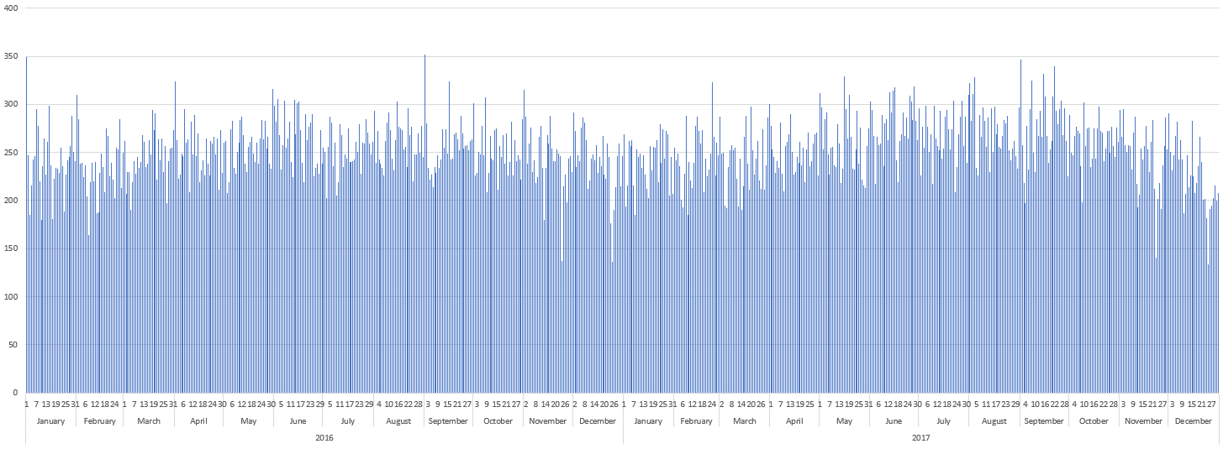
Occurred on Date

Slide 7
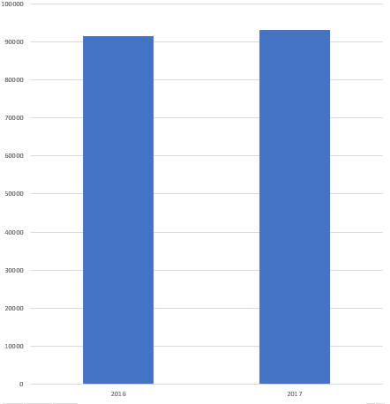
Year

Slide 8
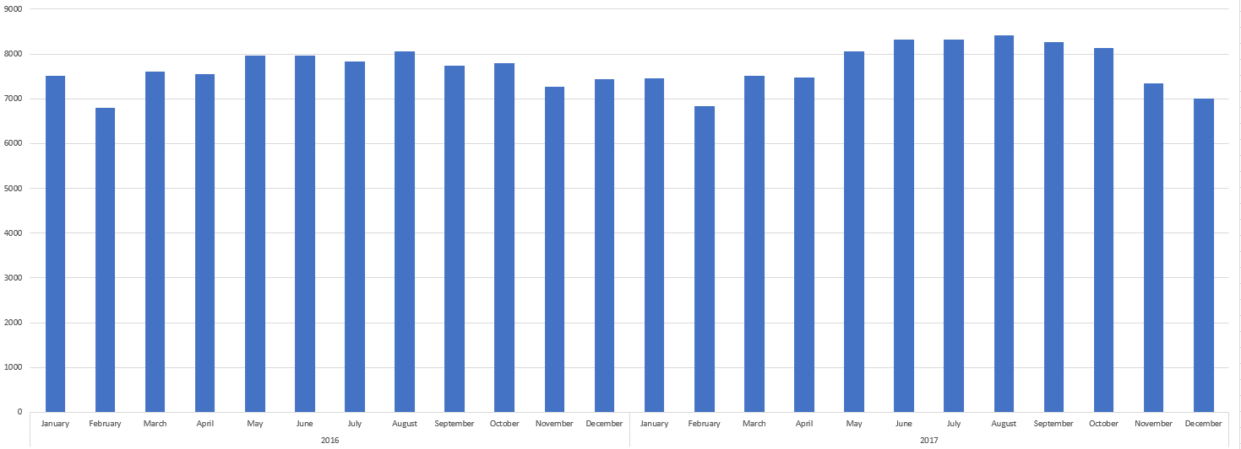
Month

Slide 9
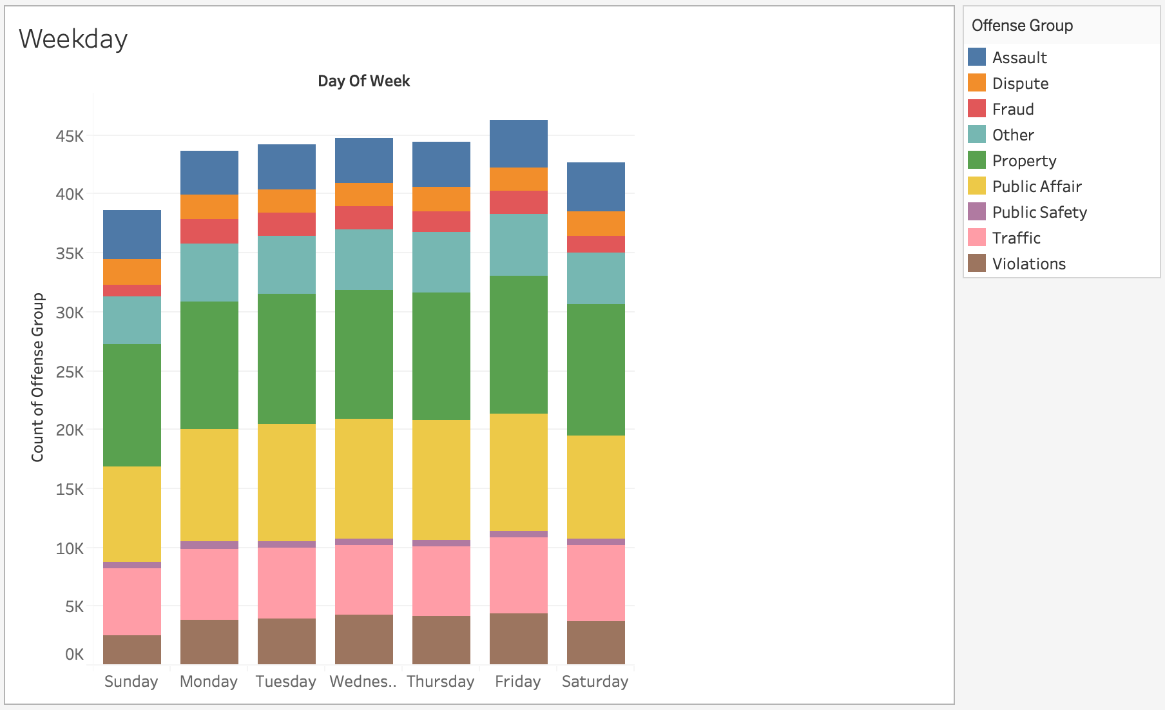
Day of Week

Slide 10
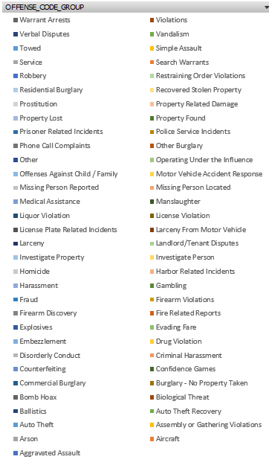
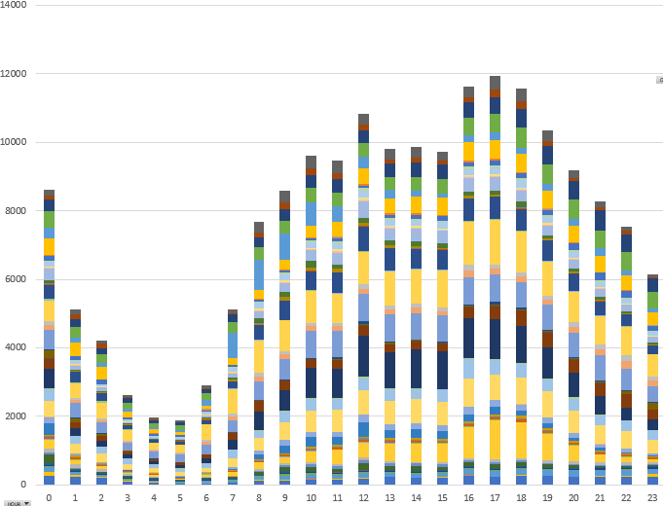
Hour

Slide 11
Crime group: Assault
Crime rate: Frequency of Assault in days of week

Slide 12
1
Discover Periodic Patterns
Tasks
Part 1
2
Discover Spatial Patterns
3
Discover Relationship with Weather

Slide 13
1
Tasks
Part 2
Pedestrian Safety Reminder
2
Route Suggestion (Option)

Slide 14
Clock
Map
Design
Parallel Coordinates
Treemaps
Word Cloud

Slide 15
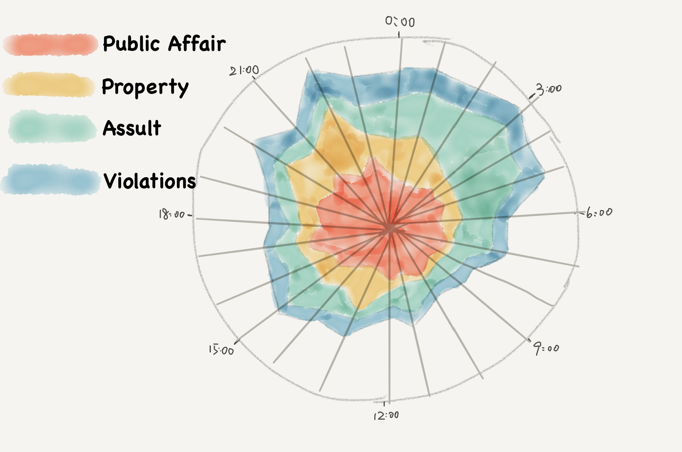
Discover Period Patterns
Clock Design

Slide 16
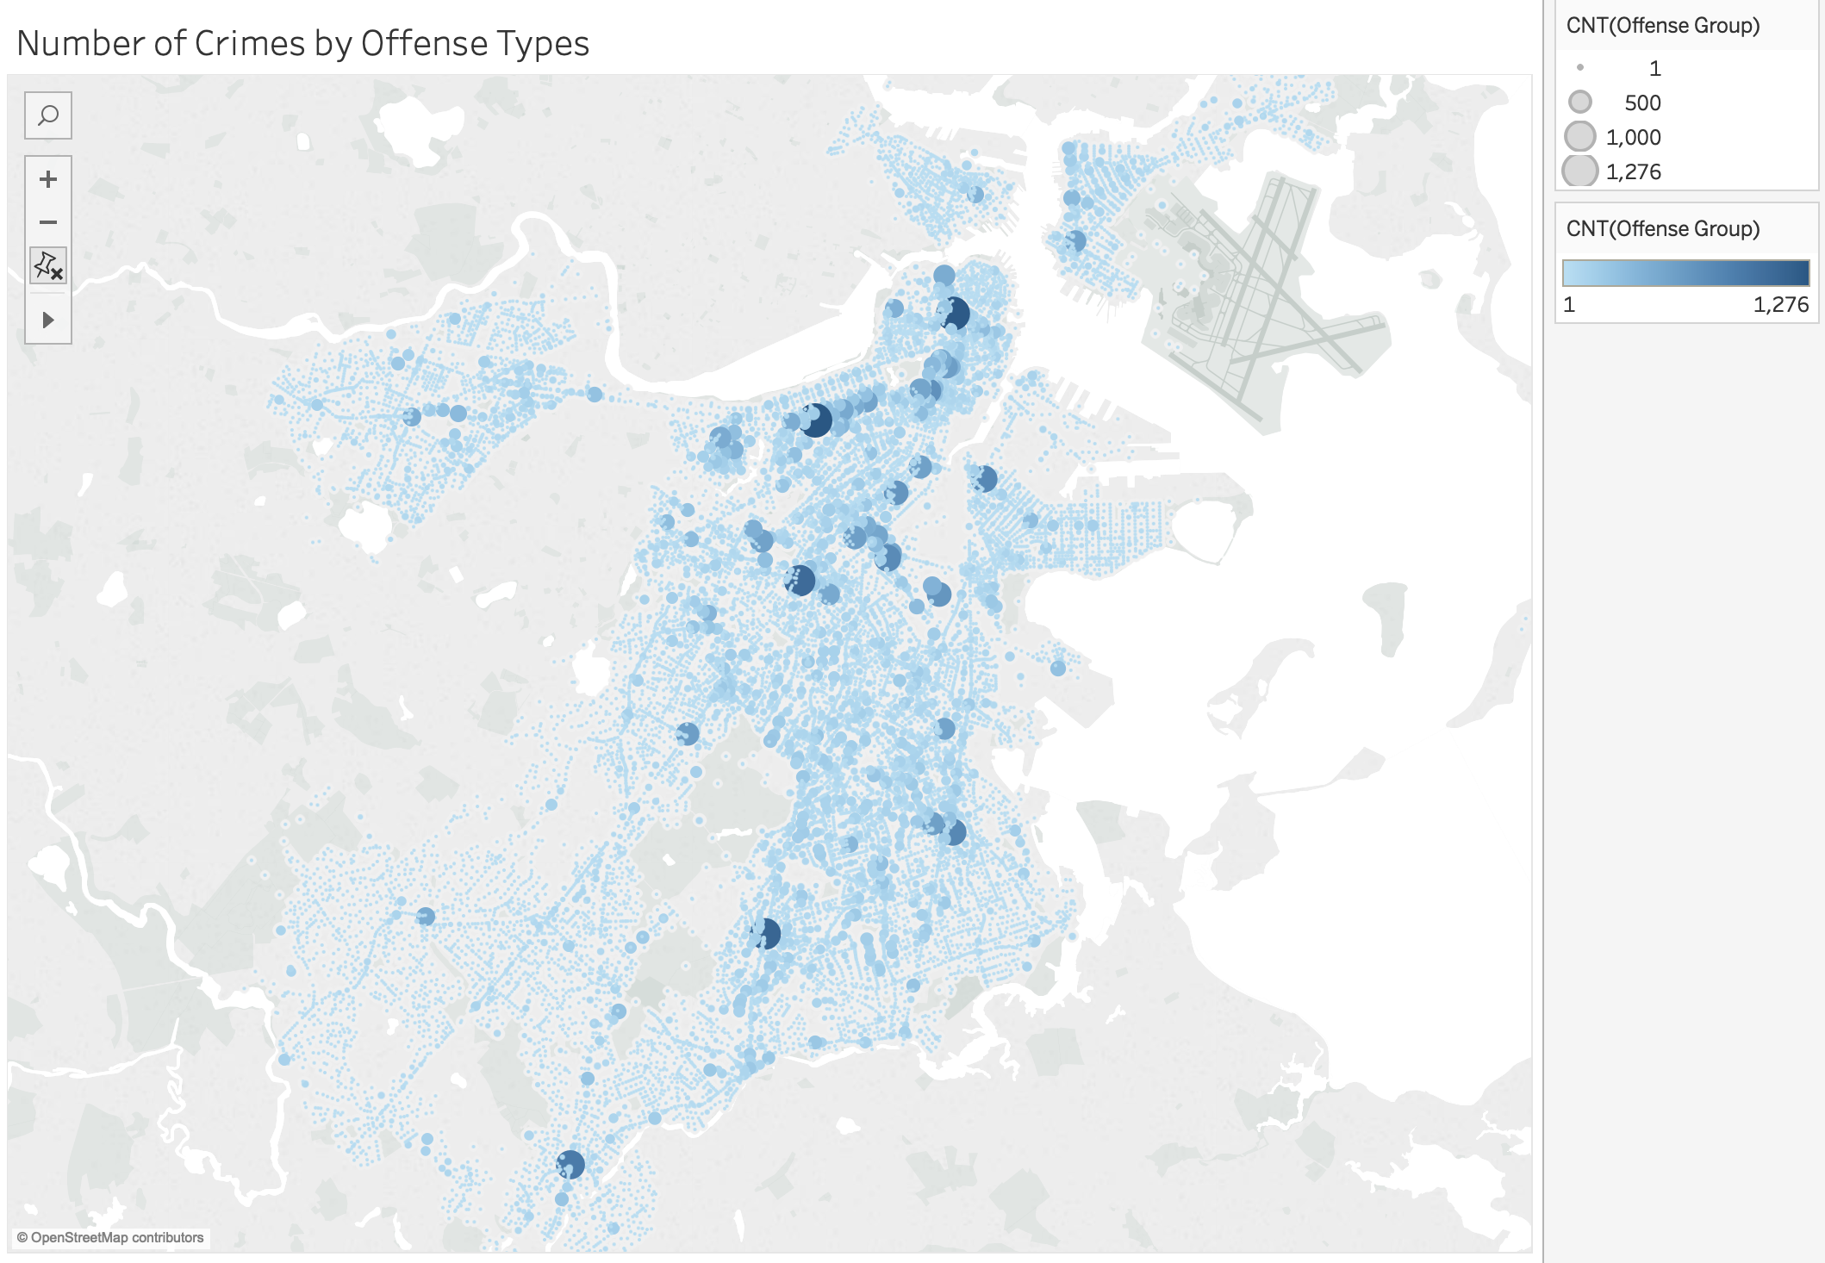
Discover Spatial Patterns
Map Design

Slide 17
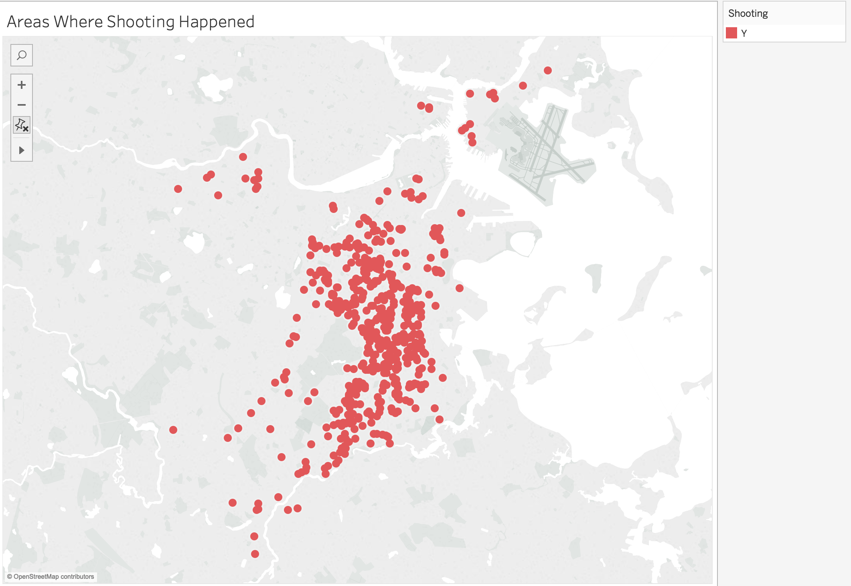
Discover Spatial Patterns
Map Design

Slide 18
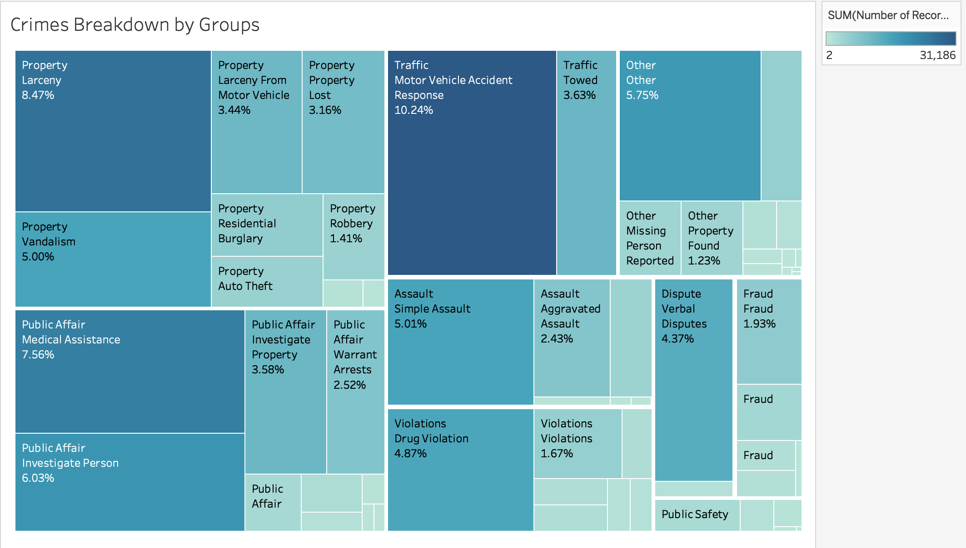
Safety Reminder
Treemap

Slide 19
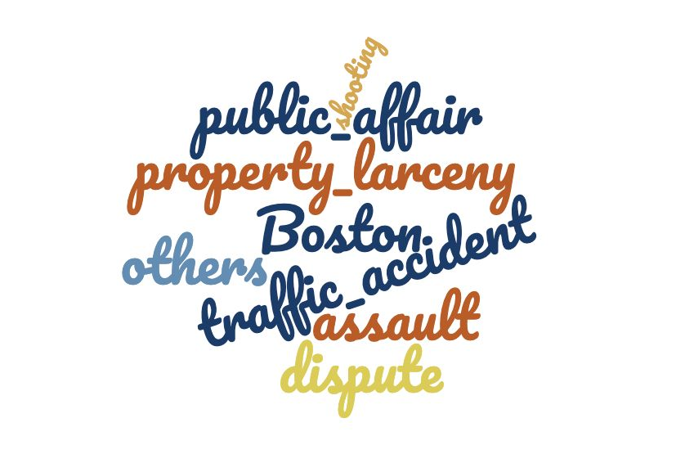
Crime
Features
Word Cloud

Slide 20
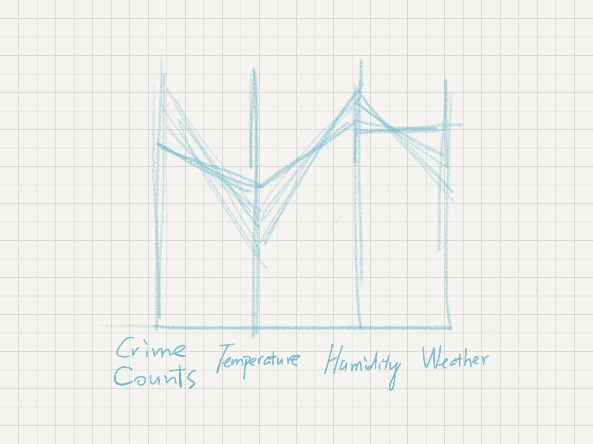
Discover Relationship with Weather
Parallel Coordinate

Slide 21
Task Part 2 - Safety Reminder & Route Suggestion
Type in location and destination.
A
1X
D
B
There is another parallel coordinate which reveals the relationship between weather and crime frequency.
For each route, system provide a detailed view of crime frequency and severe crimes.
Safety Reminder
C
User can choose different start time as a filter.

Slide 22
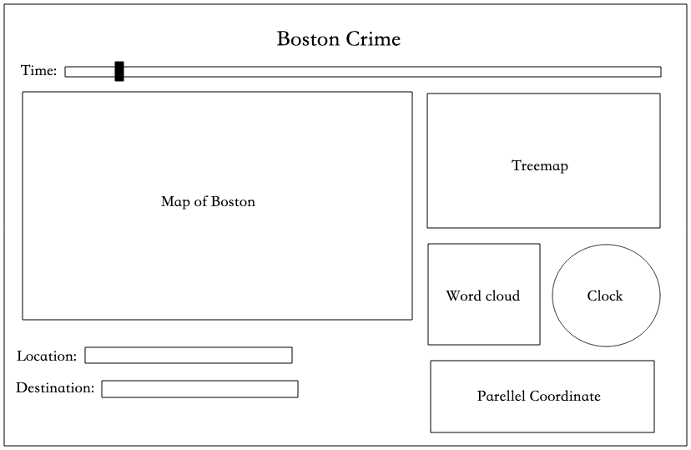
Task Part 2 - Safety Reminder & Route Suggestion

Slide 23




Complex Charts
Implementation
1
2
3
4
Pre-process
Basic Charts
Map &
Navigation

Slide 24
THANKS !

